Slide 1
CONTROLLING

Slide 2
What is Controlling?
The process of measuring performance and taking action to ensure desired results.
It helps ensure that objectives and accomplishments are consistent with one another throughout an organization.
It helps maintain compliance with essential organizational rules and policies.
Done well, it ensures that the overall directions of individuals and groups are consistent with short and long range plans.

Slide 3
Why is controlling important?
Controlling is an important function of management. Its importance becomes apparent when we find that it is needed in all the functions of management. Controlling checks mistakes and tells us how new challenges can be met or faced. The success of the organisation thus hinges on the effective controlling.
Controlling is the last function of the management process which is performed after planning, organising, staffing and directing. On the other hand, management control means the process to be adopted in order to complete the function of controlling.

Slide 4
The importance of controlling becomes clear from the following facts:
(1) Accomplishing Organisational Goals:
The controlling process is implemented to take care of the plans. With the help of controlling, deviations are immediately detected and corrective action is taken. Therefore, the difference between the expected results and the actual results is reduced to the minimum. In this way, controlling is helpful in achieving the goals of the organisation.
(2) Judging Accuracy of Standards:
While performing the function of controlling, a manager compares the actual work performance with the standards. He tries to find out whether the laid down standards are not more or less than the general standards. In case of need, they are redefined.

Slide 5
(3) Making Efficient Use of Resources:
Controlling makes it possible to use human and physical resources efficiently. Under controlling, it is ensured that no employee deliberately delays his work performance. In the same way, wastage in all the physical resources is checked.
(4) Improving Employee Motivation:
Through the medium of controlling, an effort is made to motivate the employees. The implementation of controlling makes all the employees to work with complete dedication because they know that their work performance will be evaluated and if the progress report is satisfactory, they will have their identity established in the organisation.
(5) Ensuring Order and Discipline:
Controlling ensures order and discipline. With its implementation, all the undesirable activities like theft, corruption, delay in work and uncooperative attitude are checked.

Slide 6
(6) Facilitating Coordination in Action:
Coordination among all the departments of the organisation is necessary in order to achieve the organisational objectives successfully. All the departments of the organisation are interdependent. For example, the supply of orders by the sales department depends on the production of goods by the production department.
Through the medium of controlling an effort is made to find out whether the production is being carried out in accordance with the orders received. If not, the causes of deviation are found out and corrective action is initiated and hence, coordination between both the departments is established.

Slide 7
The link between planning and controlling
Control and planning are interrelated so closely that they cannot be separated from each other. Without control all the planning is fruitless because control consists of the steps taken to ensure that the performance of the organization conforms to the plans.
In other words control is concerned with the actual performance in relation to the standards set in advance and the correction of deviations to ensure attainment of objectives. Planning is required at the very outset of management whereas control is required at the last stages.
If planning is looking ahead, control is looking back. In fact, control is the process of checking to determine whether or not proper progress is being made towards the objectives and goals set by management while doing planning.

Slide 8
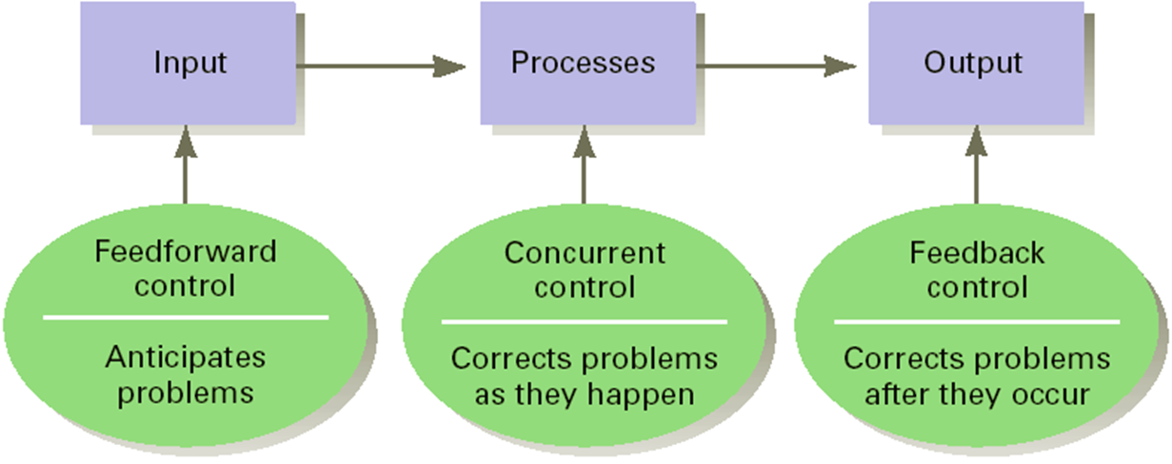
What are the 3 different types of controlling?

Slide 9
Feed-forward Control
Control that takes place before work is performed. Managers using this type of control create policies, procedures and rules aimed at eliminating behavior that will cause undesirable work results. This type of control is helpful to managers because it allows a manager to plan work effectively. Although this control can be costly and can slow down the planning process, they help to avoid problems later on.

Slide 10
Concurrent control
This refers to the control that takes place as work is being performed. this means that systems are monitored in real-time. Concurrent controls begin with standards and all employee activity is measured against the standard. Usually these include quality control standards.This means that products and services can be checked as they are being produced or performed to be sure that the highest quality product or service is being produced or provided.

Slide 11
Feedback control
This refers to the control that concentrates on the post organizational performance. Managers exercising this type of control are attempting to take corrective action by looking at organizational history over a specified time period. This history may involve one factor, such as inventory levels, and may involve the relationships among many factors, such as net income before taxes, sales volume and marketing cost.

Slide 12
Steps in control process
1. Establishing Standards and Methods for Measuring Performance
2. Measuring the Performance
3. Determination of Whether the Performance Matches the Standard
4. Taking Corrective Action.

Slide 13
Establishing Standards and Methods for Measuring Performance
a company must develop, document and explain clear standards and methods for measuring particular performances. These must be specific and understood so effective measuring of tasks and responsibilities can take place. In this way, an enterprise can gain a good understanding of who is performing according to company objectives. Proper standards and methods for measuring performance helps a company tweak their processes as required for better results. Performance measurement helps them see where their processes and procedures need improvement.

Slide 14
Measuring the Performance
this must be done in a consistent, regular manner to facilitate proper data acquisition to make informed decisions concerning performance. This regular measuring gives management substantial information so they can again make adjustments as necessary to their protocols.

Slide 15
Determining Whether the Performance Matches the Standard
company management compares measured results with the standards they previously established. Therefore, they can determine if performance is up to their expectations - or not. With this comparing, they can decide to abandon certain policies, procedures or tasks, modify them, or leave them in place.

Slide 16
Taking Corrective Action
a company must use the information gathered from the control process. Not taking action based on revealed information (which shows inefficiencies and/or poor employee performance) means they wasted their time and resources instituting the control process. They must take action that gives solutions to problems. They must then measure these corrective actions some time down the road to see if they are performing up to corporate expectations. Consequently, the control process is something that is ongoing in organizations to make sure that the business is performing optimally

Slide 17
Characteristics Of Effective Control Systems
Accurate. Information on performance must be accurate. Evaluating the accuracy of the information they receive is one of the most important control tasks that managers face.
Timely. Information must be collected, routed, and evaluated quickly if action is to be taken in time to produce improvements.
Objective and Comprehensible. The information in a control system should be understandable and be seen as objective by the individuals who use it. A difficult-to understand control system will cause unnecessary mistakes and confusion or frustration among employees.

Slide 18
Focused on Strategic Control Points. The control system should be focused on those areas where deviations from the standards are most likely to take place or where deviations would lead to the greatest harm.
Economically Realistic. The cost of implementing a control system should be less than, or at most equal to, the benefits derived from the control system.
Organizational Realistic. The control system has to be compatible with organizational realities and all standards for performance must be realistic.
Coordinated with the Organization's Work Flow. Control information needs to be coordinated with the flow of work through the organization for two reasons: (1) each step in the work process may affect the success or failure of the entire operation, (2) the control information must get to all the people who need to receive it.

Slide 19
Flexible. Controls must have flexibility built into them so that the organizations can react quickly to overcome adverse changes or to take advantage of new opportunities.
Prescriptive and Operational. Control systems ought to indicate, upon the detection of the deviation from standards, what corrective action should be taken.
Accepted by Organization Members. For a control system to be accepted by organization members, the controls must be related to meaningful and accepted goals.
These characteristics can be applied to controls at all levels of the organization.

